Slide 1
Objectives
Using Stanza for NER
Building Language model

Slide 2
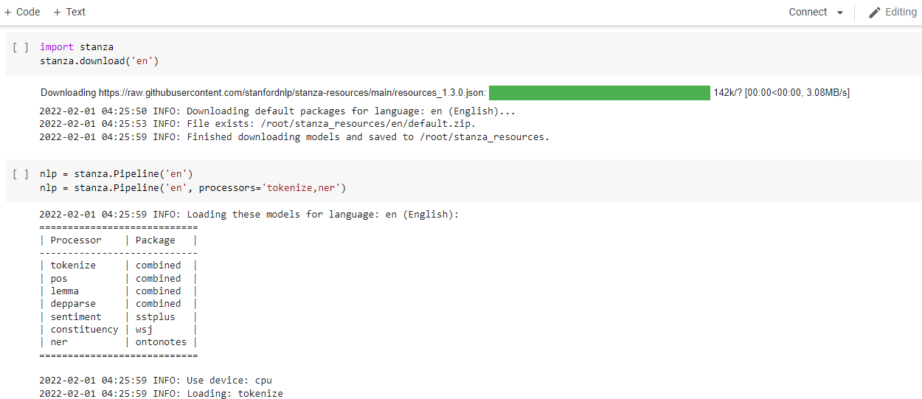
Working on Stanza

Slide 3
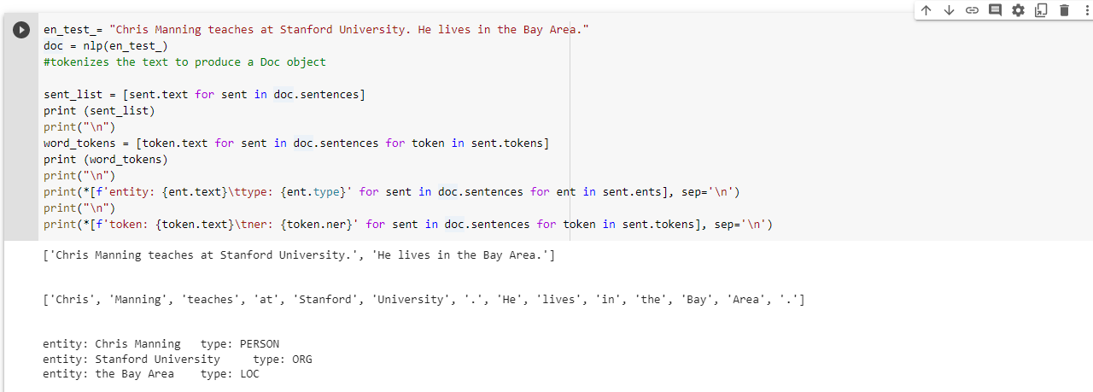

Slide 4
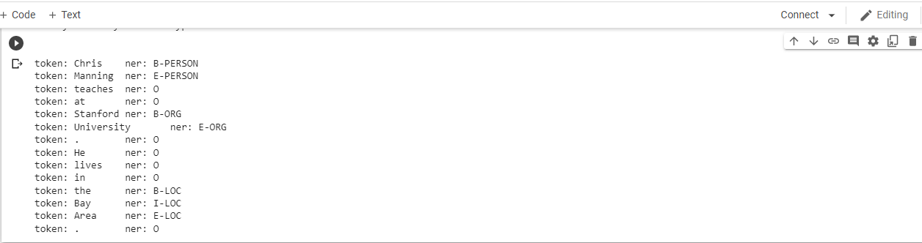

Slide 5
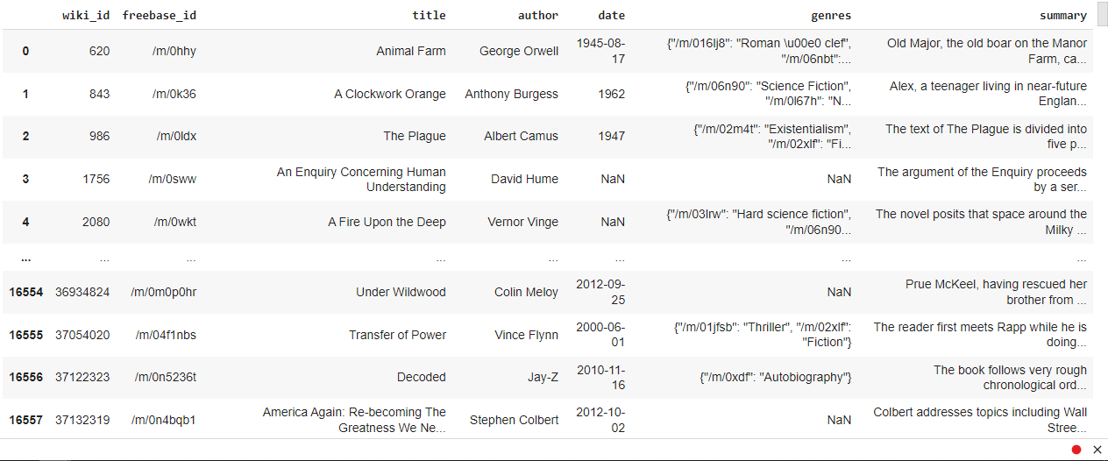
Building Language Model

Slide 6
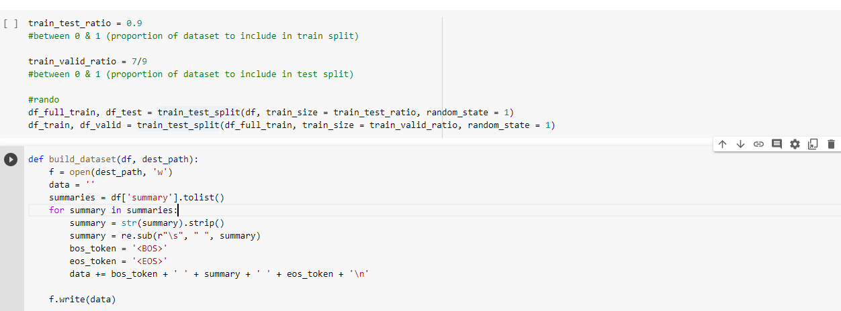
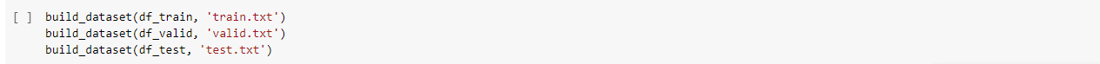

Slide 7
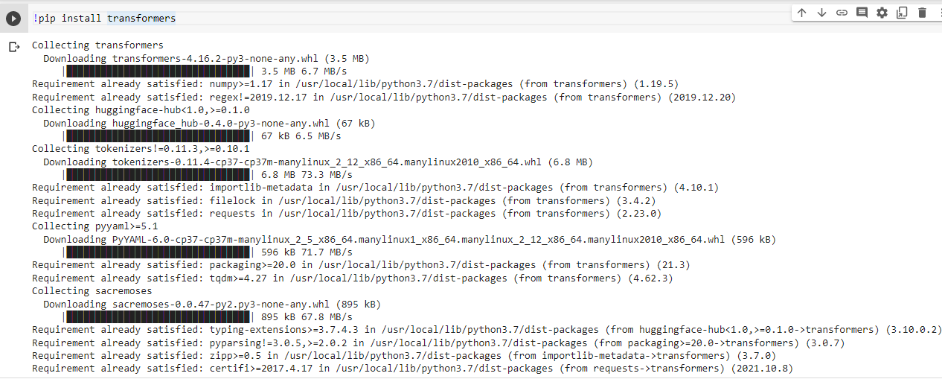

Slide 8
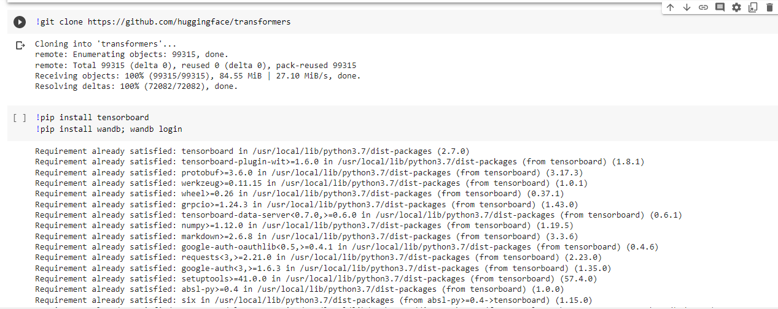

Slide 9
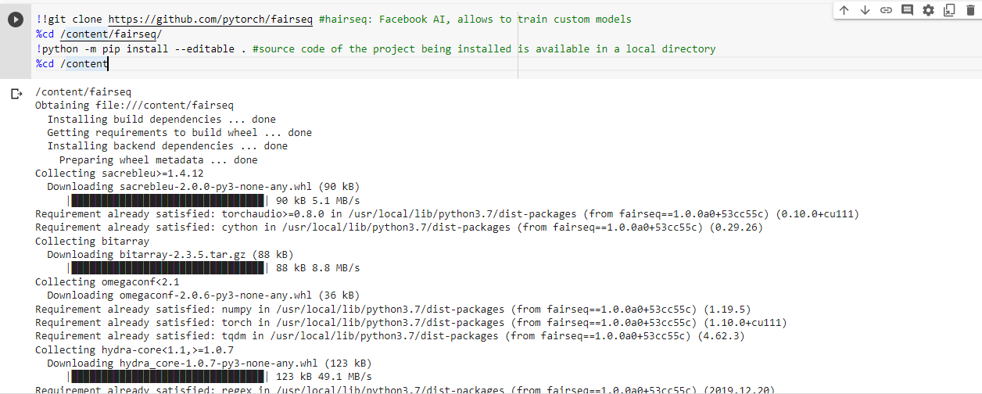

Slide 10
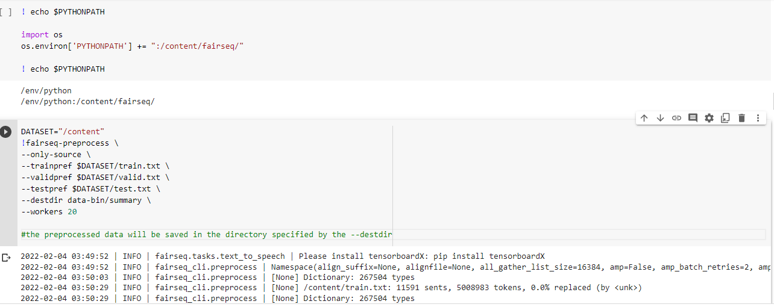

Slide 11
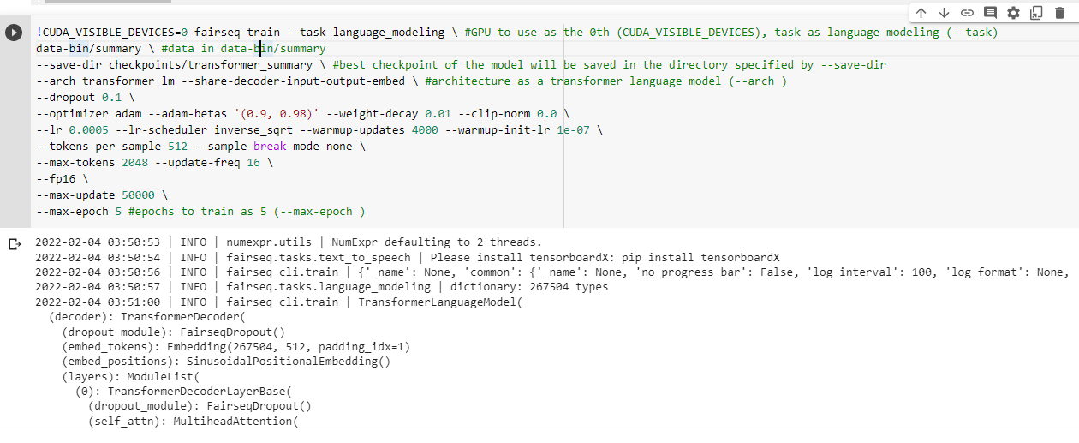

Slide 12
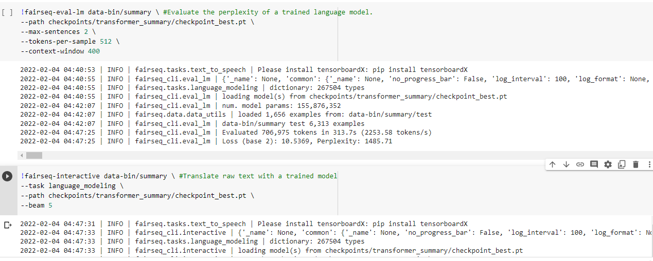

Slide 13
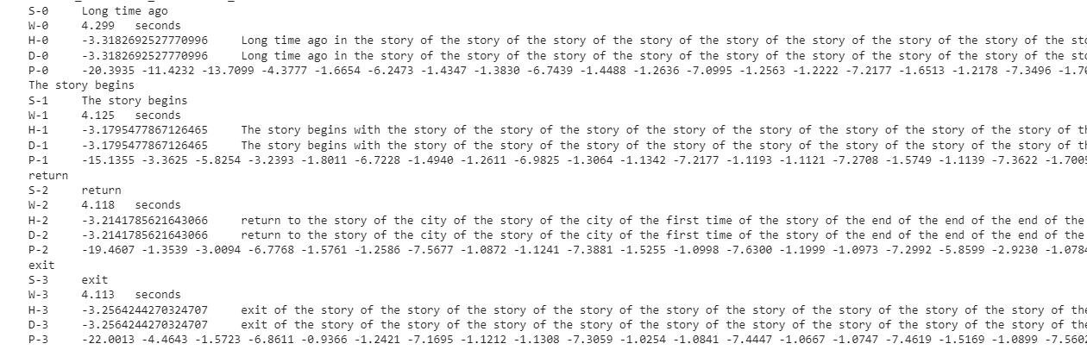

Slide 14
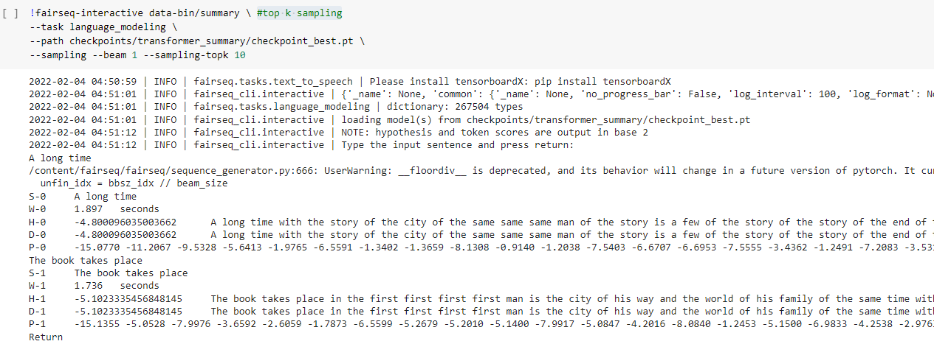

Slide 15
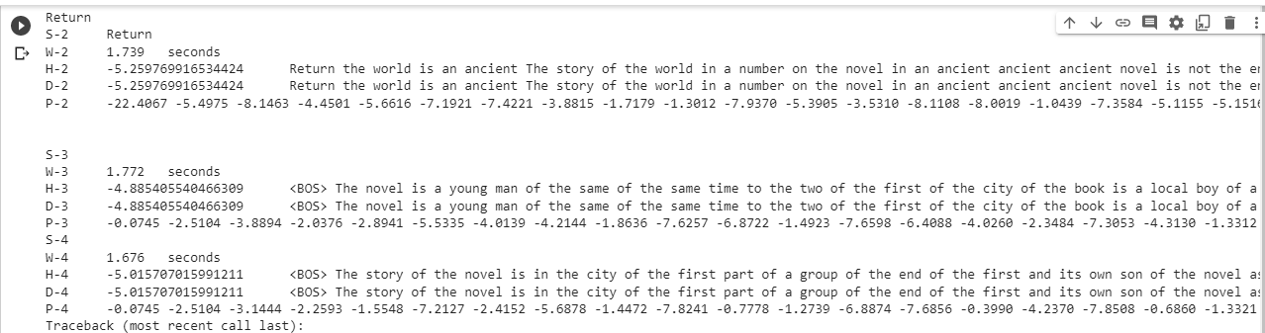

Slide 16
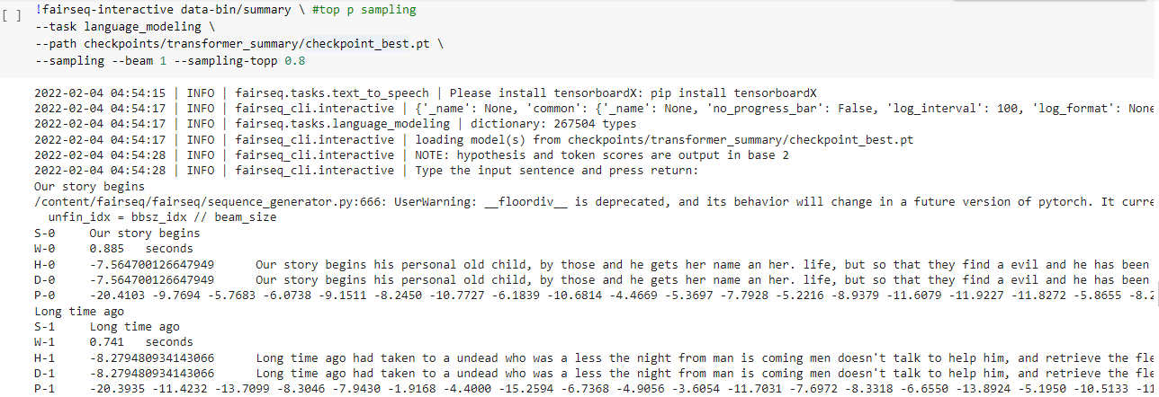

Slide 17
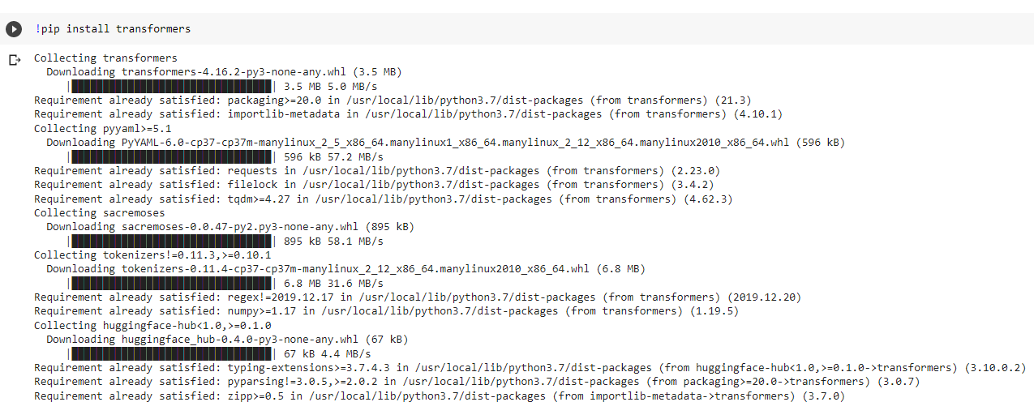
Text generation with Huggingface

Slide 18
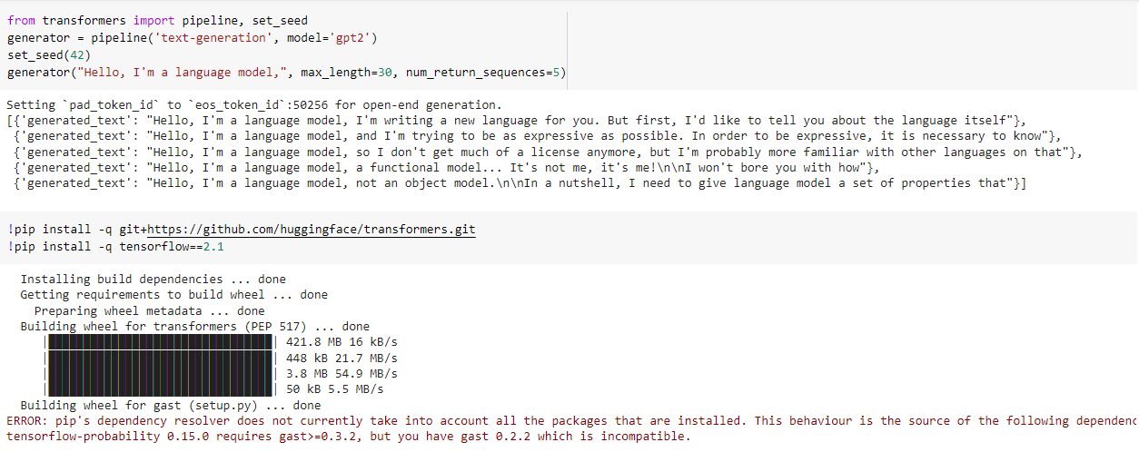

Slide 19
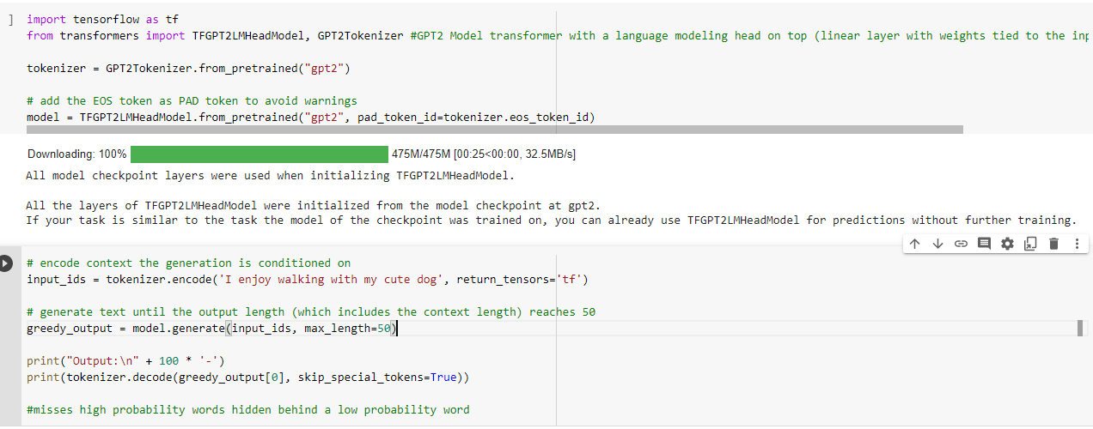
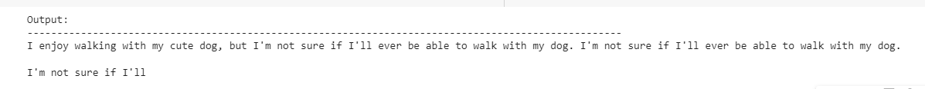

Slide 20
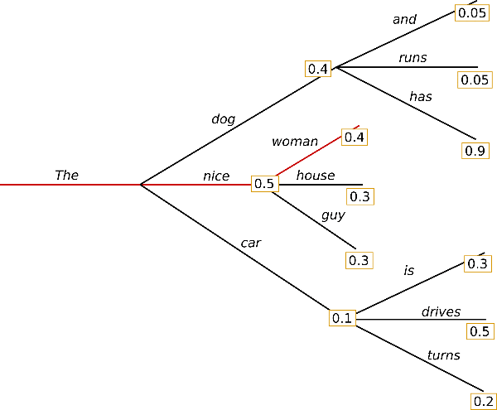
Greedy search
Starting from the word "The”.
Algorithm greedily chooses the next word of highest probability "nice" and so on.
Final generated word sequence is ("The","nice","woman")
Overall probability of 0.5 X 0.4 = 0.20
Word "has" with its high conditional probability of 0.9 is hidden behind the word "dog", which has only the second-highest conditional probability
Greedy search misses the word sequence "The","dog","has" .

Slide 21
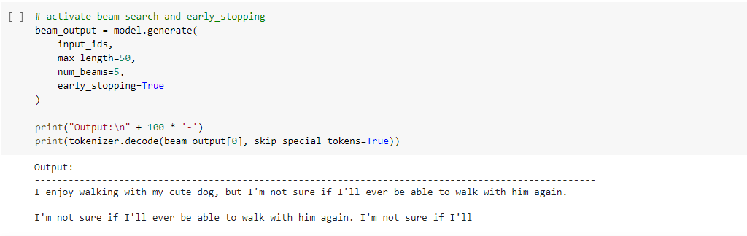
Beam Search

Slide 22
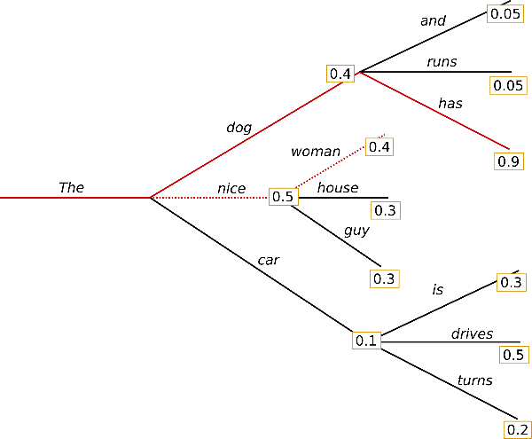
At time step 1, besides the most likely hypothesis "The", "nice” ("The","nice")
Also keeps track of the second most likely one "The", "dog” ("The","dog").
Beam search finds that the word sequence "The", "dog”, "has” ("The","dog","has"), has with 0.36 a higher probability than "The", "nice", "woman“ ("The","nice","woman"), which has 0.20
Beam search will always find an output sequence with higher probability than greedy search, but is not guaranteed to find the most likely output

